Slide 1
CRYPTOGRAPHY Lecture1
By: Dr. M. Umar Aftab

Slide 2
KEY TERMINOLOGIES
plaintext - the original message
ciphertext - the coded message
key - information used in encryption/decryption, and known only to sender/receiver
encipher (encrypt) - converting plaintext to ciphertext using key
decipher (decrypt) - recovering ciphertext from plaintext using key
cryptography - study of encryption principles/methods/designs
cryptanalysis (code breaking) - the study of principles/ methods of deciphering ciphertext

Slide 3
CRYPTOGRAPHIC SYSTEMS
The operations used in transferring plaintext to cipher text:
  Substitution: each element in the plaintext is mapped into another element
  Transposition: the elements in the plaintext are re-arranged.
The number of keys used:
  Symmetric (private- key) : both the sender and receiver use the same key
  Asymmetric (public-key) : sender and receiver use different key
How plaintext is processed :
  Block cipher : inputs are processed one block at a time, producing a corresponding output block.
  Stream cipher: inputs are processed continuously, producing one
element at a time (bit, byte)

Slide 4
REQUIREMENTS OF CRYPTOGRAPHIC SYSTEM
Two requirements for secure use of symmetric
encryption:
  a strong encryption algorithm
  a secret key known only to sender / receiver
Y = Ek(X), where X: the plaintext, Y: the ciphertext
X = Dk(Y)
•assume encryption algorithm is known to parties
•implies a secure channel to distribute key

Slide 5
CLASSICAL ENCRYPTION TECHNIQUES
Classical Ciphers can be divided into two main
categories:
Substitution Ciphers
Transposition Cipher

Slide 6
1. SUBSTITUTION CIPHERS
Monoalphabetic Substitution
  Caesar Cipher
  Affine Cipher
Polyalphabetic Substitution
  Playfair Cipher
  Hill Cipher
  Vigenere Cipher

Slide 7
2. TRANSPOSITION CIPHERS
Rail Fence
Row Transposition
Rotormachine

Slide 8
MONOALPHABETIC CIPHERS
Substitution Ciphers
Replaces each letter in a message with another single letter
of alphabet/symbol regardless of its position.
Our examples of the additive, shift, caesar, and
affine ciphers were monoalphabetic ciphers, that is every
letter was replaced by the same letter each time.

Slide 9
1. SUBSTITUTION CIPHERS
Monoalphabetic Substitution
  Caesar Cipher
  Affine Cipher
Polyalphabetic Substitution
  Playfair Cipher
  Hill Cipher
  Vigenere Cipher

Slide 10
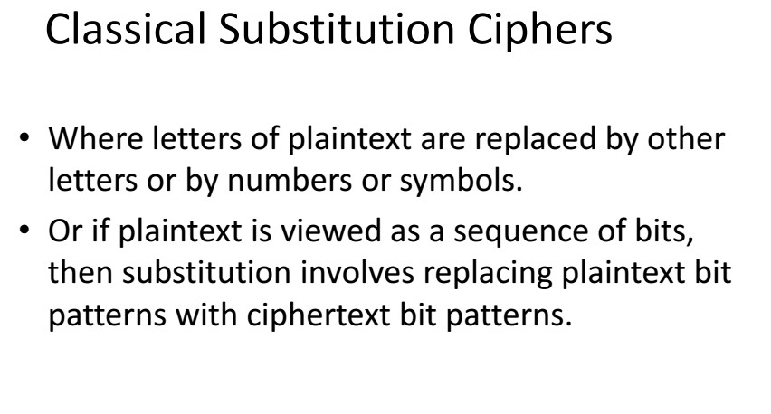

Slide 11
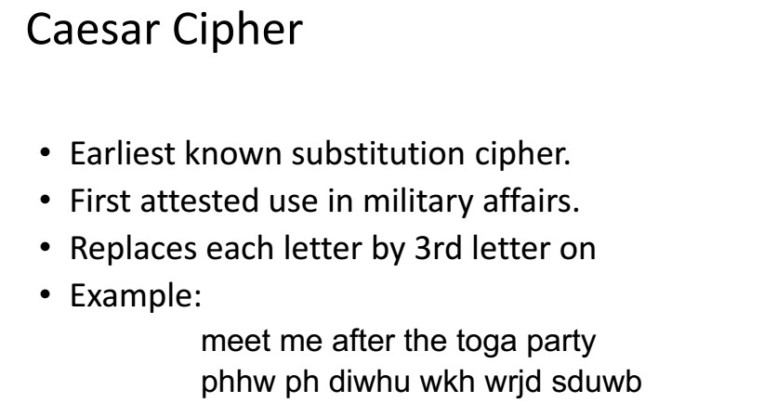

Slide 12
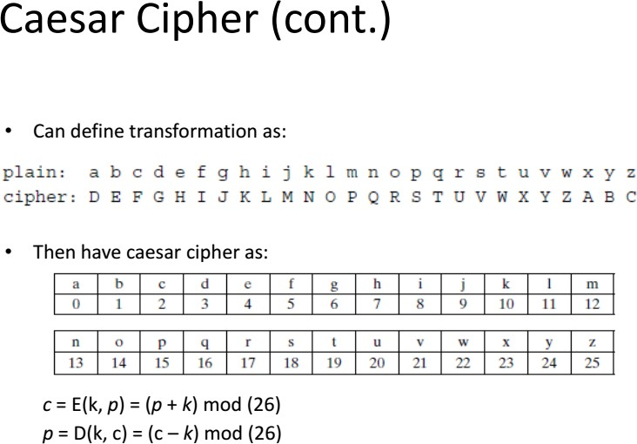

Slide 13
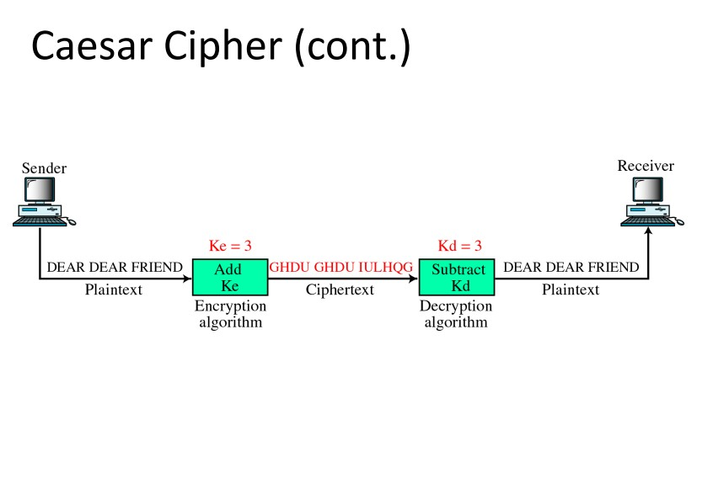

Slide 14
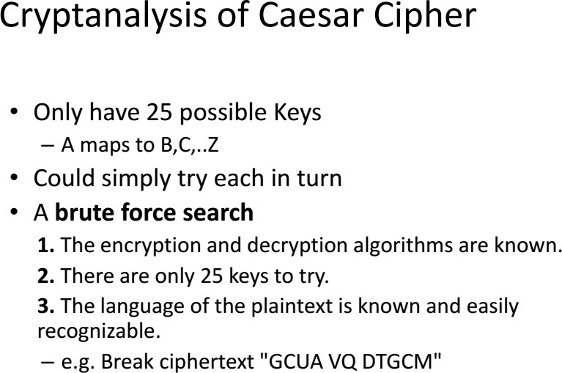

Slide 15
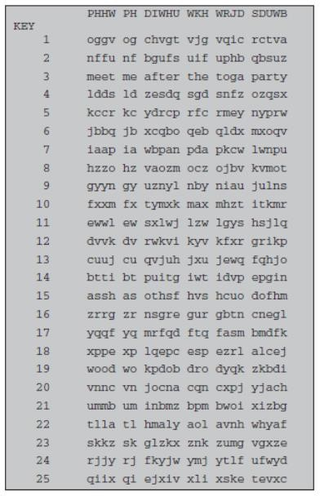

Slide 16
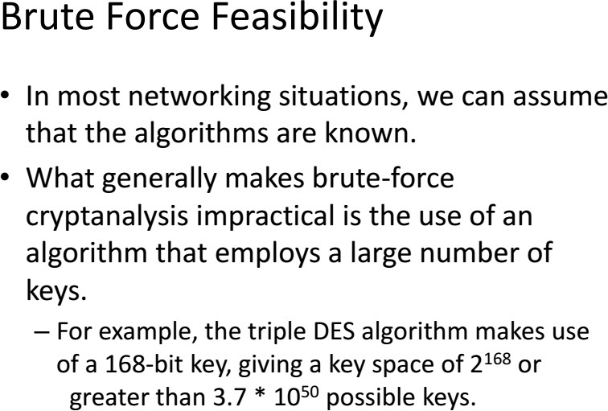

Slide 17
1. SUBSTITUTION CIPHERS
Monoalphabetic Substitution
  Caesar Cipher
  Affine Cipher
Polyalphabetic Substitution
  Playfair Cipher
  Hill Cipher
  Vigenere Cipher

Slide 18
Affine Ciphers
An encipherment scheme (or algorithm) of the form
E(x) = (ax + b) MOD 26
is called an affine cipher. Here x is the numerical equivalent of the given plaintext letter, and a and
b are (appropriately chosen) integers.
Recall that the numerical equivalents of the letters are as follows:
A | B | C | D | E | F | G | H | I | J | K | L | M
0 | 1 | 2 | 3 | 4 | 5 | 6 | 7 | 8 | 9 | 10 | 11 | 12
N | O | P | Q | R | S | T | U | V | W | X | Y | Z
13 | 14 | 15 | 16 | 17 | 18 | 19 | 20 | 21 | 22 | 23 | 24 | 25

Slide 19
Example: Encipher ITS COOL with
E(x) = (5x + 8) MOD 26.
Solution: Filling in the following table gives
plain | I | T | S | C | O | O | L
x | 8 | 19 | 18 | 2 | 14 | 14 | 11
5x + 8 | 48 | 103 | 98 | 18 | 78 | 78 | 63
(5x + 8) MOD 26 | 22 | 25 | 20 | 18 | 0 | 0 | 11
cipher | W | Z | U | S | A | A | L

Slide 20
If y = E(x) = (ax + b) MOD 26, then we can “solve for x in terms of y” and so determine E⁻¹(y). That is, if y ≡ (ax + b) (mod 26), then y − b ≡ ax (mod 26), or equivalently ax ≡ (y − b) (mod 26). Using our earlier results, we see that if we multiply both sides by a⁻¹ (mod 26), then x ≡ a⁻¹(y −b) (mod 26) and so our decipherment function is
E⁻¹(y) = a⁻¹(y − b) MOD 26.

Slide 21
Example: Decipher HPCCXAQ if the encipherment function is E(x) = (5x + 8) MOD 26.
Solution: We begin by finding the decipherment function. Since 5x ≡ 1 (mod 26) is solved with
x ≡ 21 (mod 26) we see 5⁻¹ (mod 26) = 21. Therefore,
E⁻¹(y) = 21(y − 8) MOD 26
and so filling in our table gives
cipher | H | P | C | C | X | A | Q
y | 7 | 15 | 2 | 2 | 23 | 0 | 16
y − 8 21(y − 8) | -1 -21 | 7 147 | -6 -126 | -6 -126 | 15 315 | -8 -168 | 8 168
21(y— 8) MOD 26 plain | 5 F | 17 R | 4 E | 4 E | 3 D | 14 O | 12 M

Slide 22
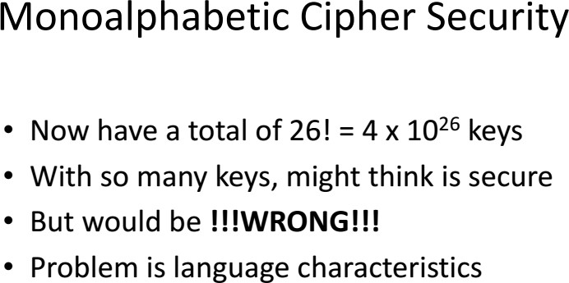

Slide 23
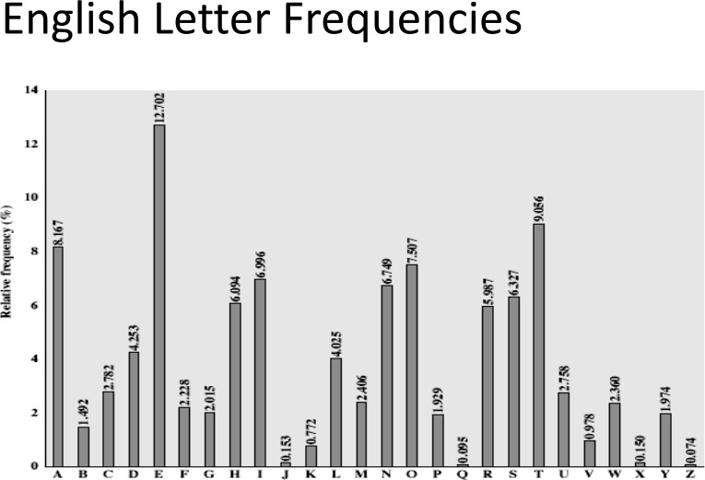

Slide 24
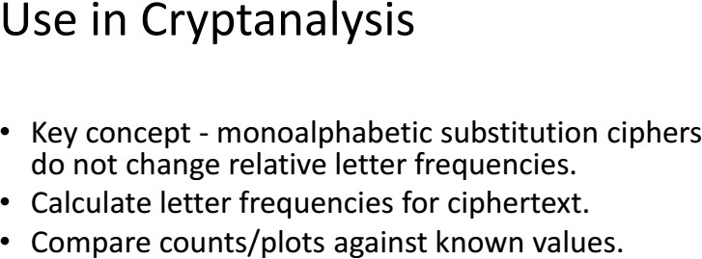

Slide 25
POLYALPHABETIC CIPHERS
Substitution Ciphers
In a polyalphabetic cipher, multiple “alphabets”
are used to encipher.
If two letters are the same in the ciphertext it does not mean they must decipher to the same plaintext letter.
  Playfair Cipher
  Hill Cipher
  Vigenere Cipher

Slide 26
Monoalphabetic Substitution
  Caesar Cipher
  Affine Cipher
Polyalphabetic Substitution
  Playfair Cipher
  Hill Cipher
  Vigenere Cipher

Slide 27
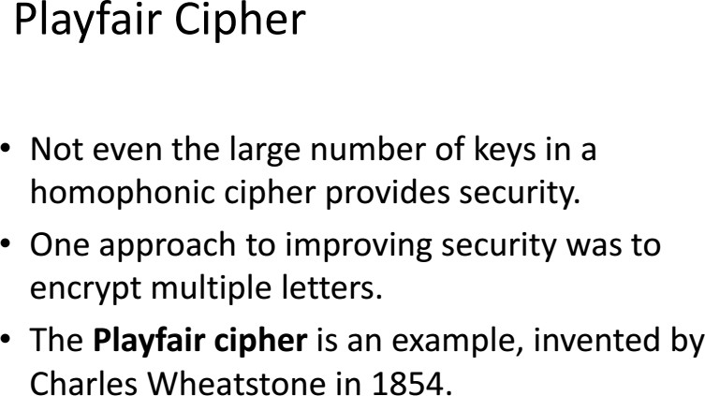

Slide 28
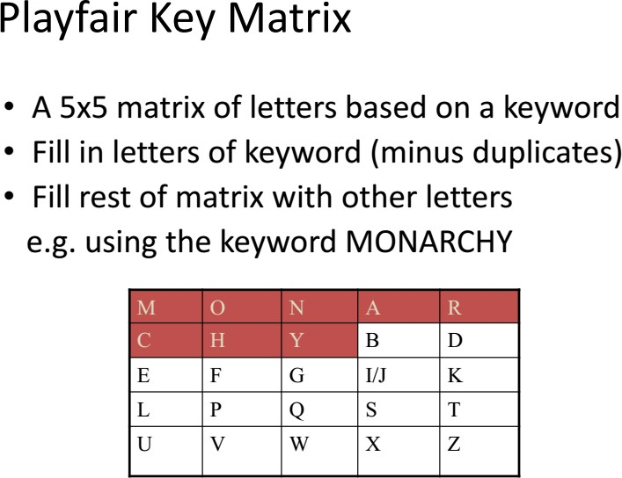

Slide 29
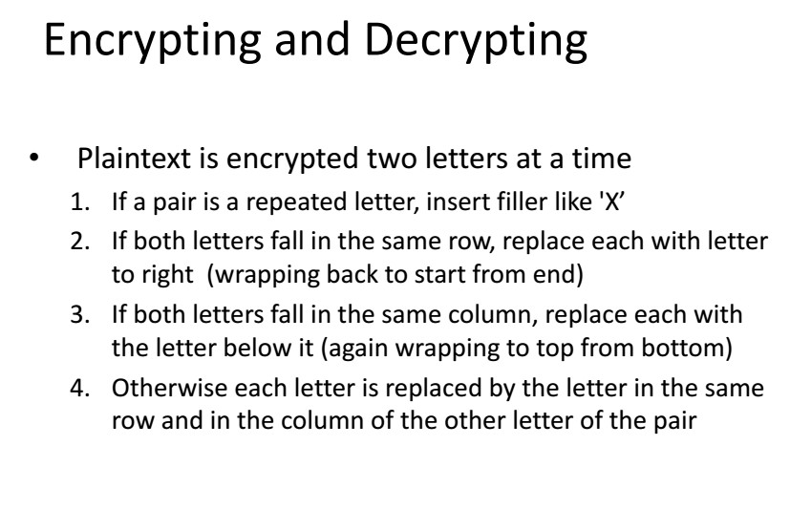

Slide 30

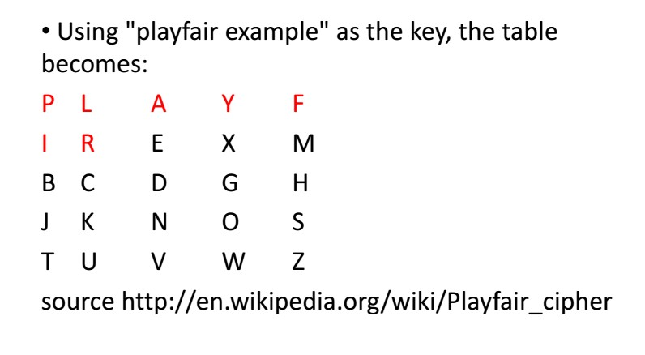
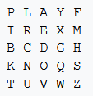
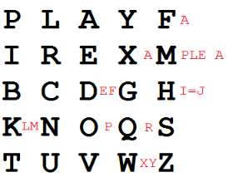
Playfair Example (1/4)

Slide 31
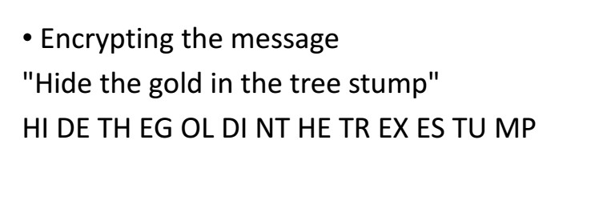
Playfair Example (2/4)
Note: Encrypting the message "Hide the gold in the tree stump" (note the null "X" used to separate the repeated "E"s)

Slide 32
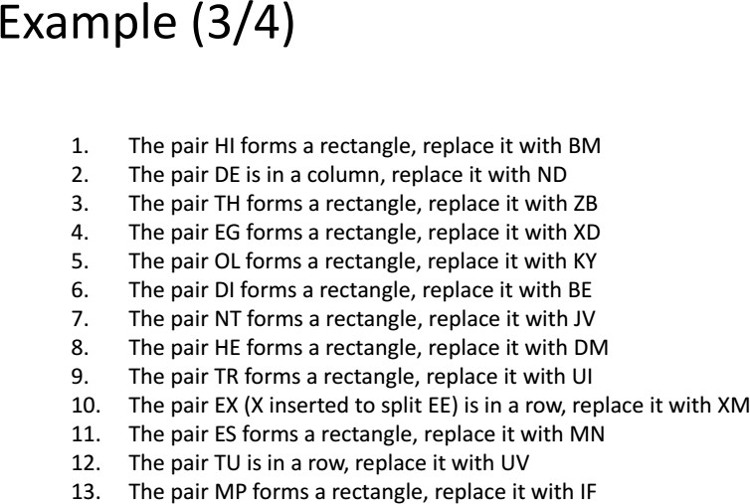
Playfair Example (3/4)

Slide 33
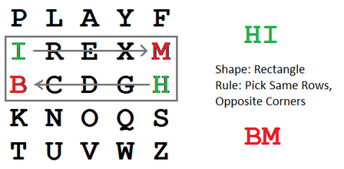
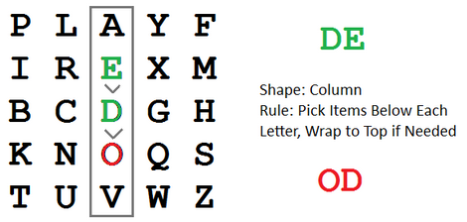
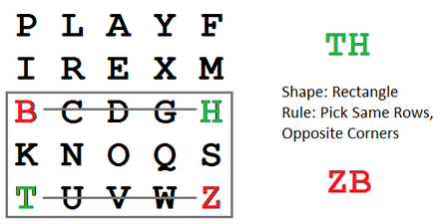
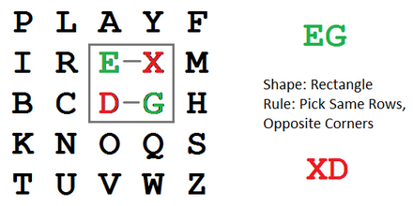
Playfair Example (3/4) Cont…

Slide 34
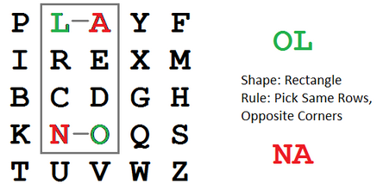
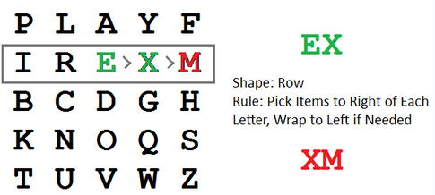
Playfair Example (3/4) Cont…
The pair DI forms a rectangle, replace it with BE
The pair NT forms a rectangle, replace it with KU
The pair HE forms a rectangle, replace it with DM
The pair TR forms a rectangle, replace it with UI
The pair ES forms a rectangle, replace it with MO
The pair TU is in a row, replace it with UV
The pair MP forms a rectangle, replace it with IF

Slide 35
Playfair Example (4/4)
Plain Text: HI DE TH EG OL DI NT HE TR EX ES TU MP
Ciphertext: BM OD ZB XD NA BE KU DM UI XM MO UV IF
Thus the message "Hide the gold in the tree stump" becomes "BMODZ BXDNA BEKUD MUIXM MOUVI F". (Breaks included for ease of reading the cipher text.)

Slide 36
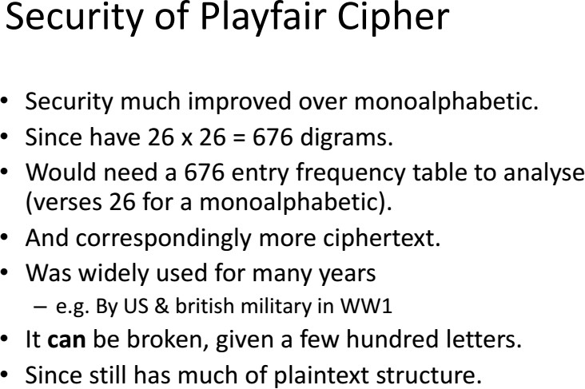

Slide 37
Monoalphabetic Substitution
  Caesar Cipher
  Affine Cipher
Polyalphabetic Substitution
  Playfair Cipher
  Hill Cipher
  Vigenere Cipher

Slide 38
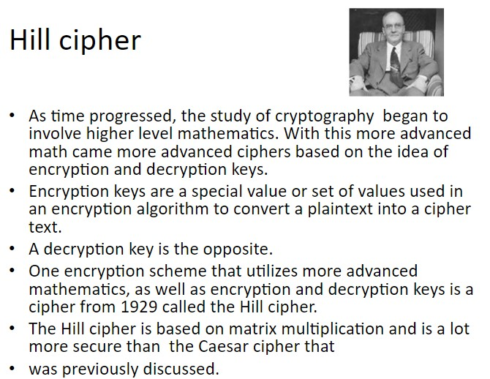


Slide 39
Hill Cipher
Another historical cipher subject to known- plaintext attacks.
Based on matrix multiplication. Take K, an MxM key representing a system of linear equations.
Ciphertext,C, and plaintext, p, are 1xM and Mx1 matricies
C=Kp (mod 26)
⎛ C₁ ⎞
⎛ ^{k}11 ^{k}12 ^{k}22
32
k₁₃ ⎞⎛ p₁ ⎞
⎜ ⎟
⎜
⎟⎜ ⎟
⎜C₂ ⎟ = ⎜ k₂₁
k₂₃ ⎟⎜ p₂ ⎟mod26
⎜ _{C} ⎟
⎜ _{k}
⎟⎜ _{p} ⎟
⎝ 3 ⎠ ⎝
k k
33 ⎠⎝ 3 ⎠
31

Slide 40
Hill Cipher
Decryption requires that the key K be invertible, i.e., K⁻¹ (mod 26)=P
The problem is the Hill cipher is subject to a known plaintext attack: we choose the plaintext and they cipher it for us.

Slide 41
Monoalphabetic Substitution
  Caesar Cipher
  Affine Cipher
Polyalphabetic Substitution
  Playfair Cipher
  Hill Cipher
  Vigenere Cipher

Slide 42
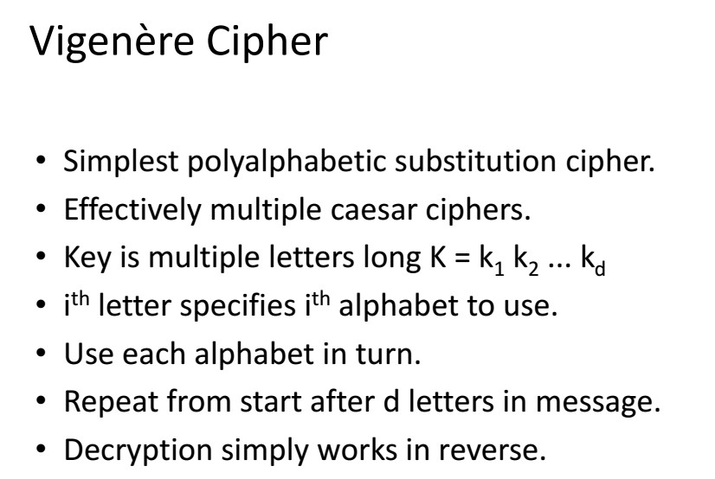

Slide 43
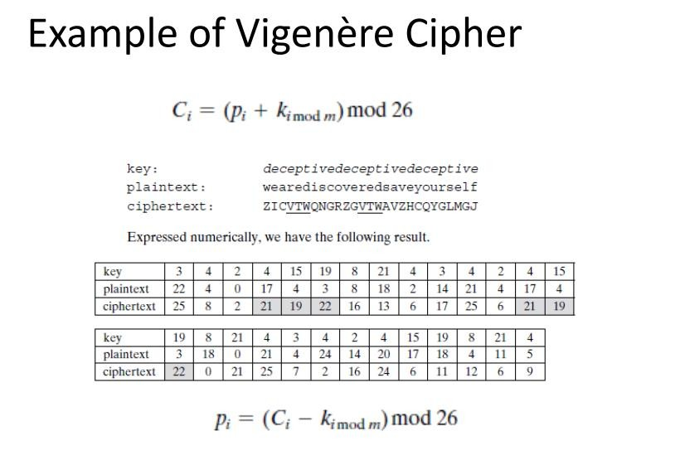

Slide 44
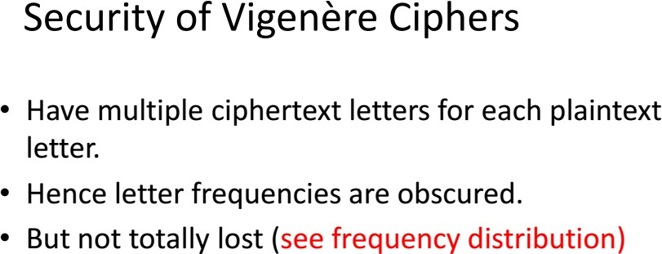

Slide 45
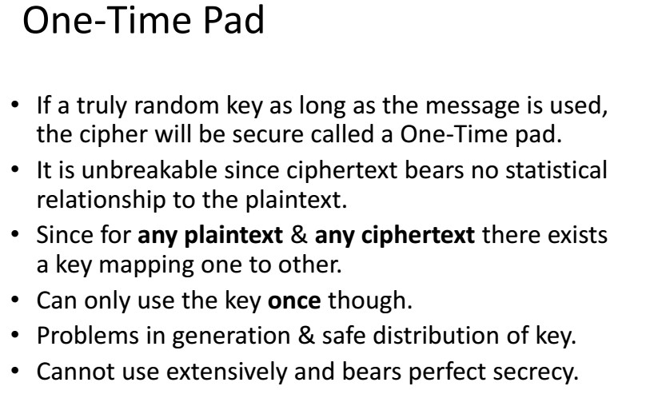

Slide 46
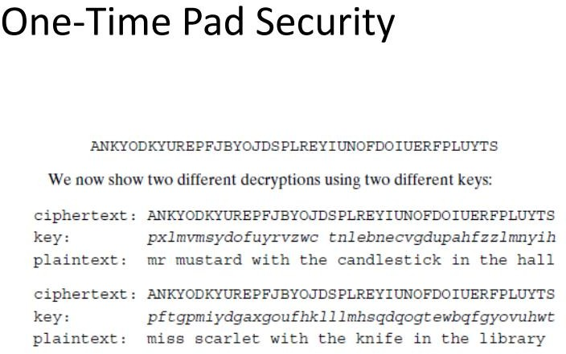

Slide 47
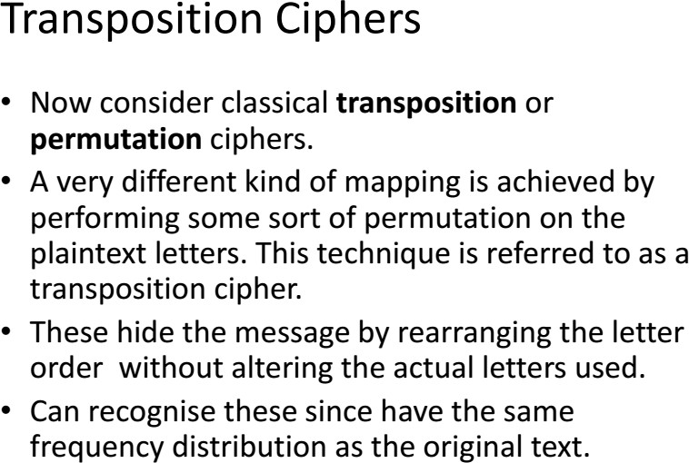

Slide 48
2. TRANSPOSITION CIPHERS
Rail Fence
Row Transposition
Rotormachine

Slide 49
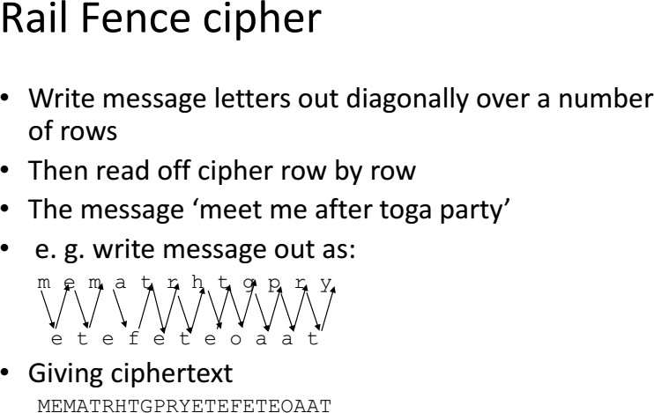

Slide 50
2. TRANSPOSITION CIPHERS
Rail Fence
Row Transposition
Rotormachine

Slide 51
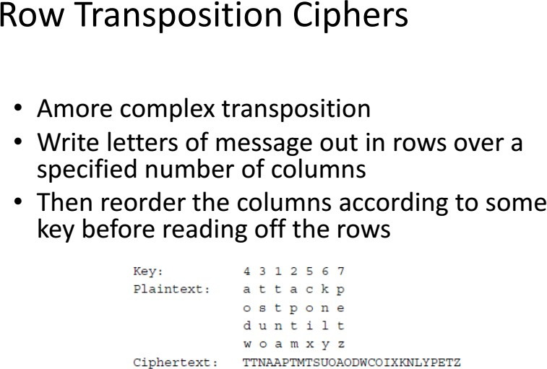

Slide 52
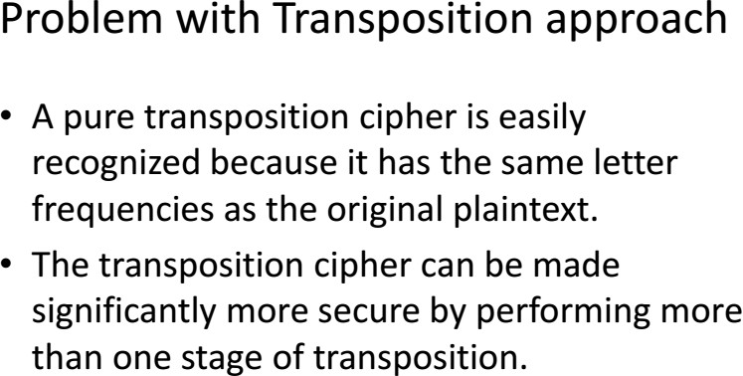

Slide 53
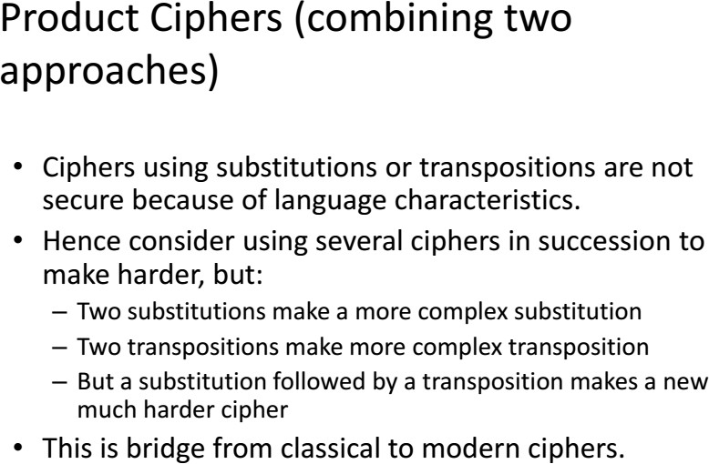

Slide 54
2. TRANSPOSITION CIPHERS
Rail Fence
Row Transposition
Rotormachine

Slide 55
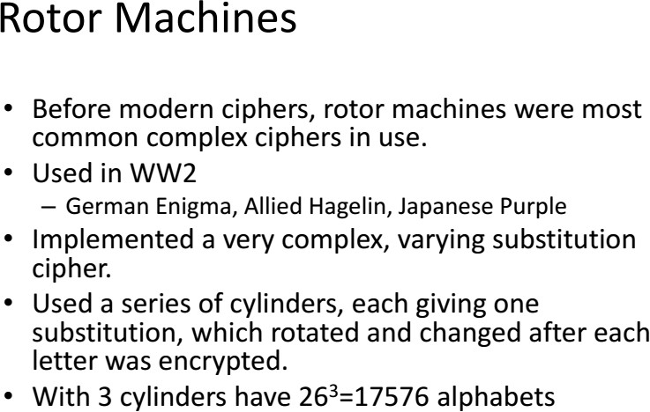

Slide 56
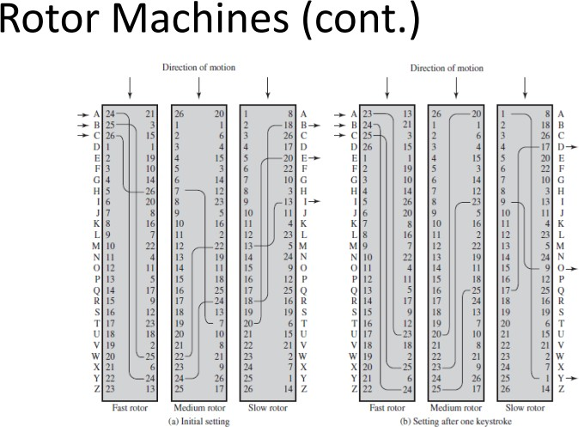

Slide 57
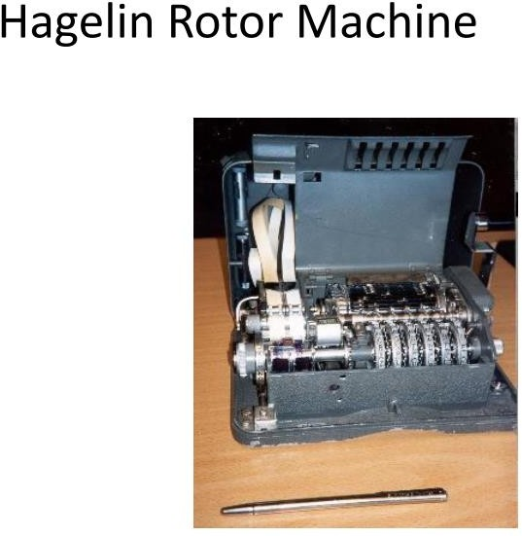

Slide 58
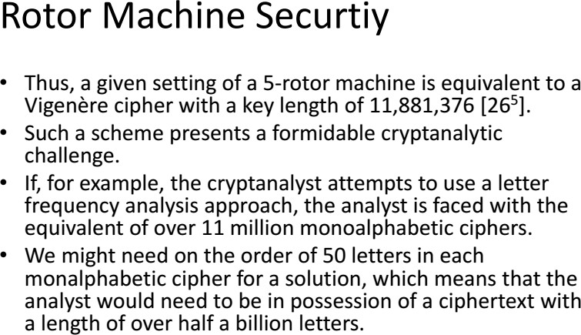

Slide 59
